Slide 1
AWS MULTI-TIER ARCHITECTURE
Presented by
Team No. 45
BODDEDA JAYA SAI AVINASH(E17CSE018)
C R NITHESHWAR(E17CSE045)
Submitted
to
DEPARTMENT OF COMPUTER SCIENCE ENGINEERING
BENNETT UNIVERSITY, GREATER NOIDA, 201310, UTTAR PRADESH, INDIA

Slide 2
OUTLINE
Introduction & Background
Problem Statement
Social Importance/Relevance of the Problem
Proposed Solution
Experiment and Implementation
Results Analysis and Validation
Conclusion and Future Work
References

Slide 3
Introduction & Background
Since Telecomm industry usually suffers from higher churn rate which henceforth affects the company sales.
To avoid that,
We have built a XGBoost algorithm for machine learning and is based on a decision tree using a gradient boosting method. To interact with the model, we created a website using flask and secured with AWS multi-tier Architecture.
Total work was done in the AWS cloud we used various services of cloud, like Sagemaker for Machine learning with help of the API we created a user interface for the model and The architecture provides better security to secure a web application.
The Multi-Tier Architecture will be detailly explained from slide-9 onwards

Slide 4
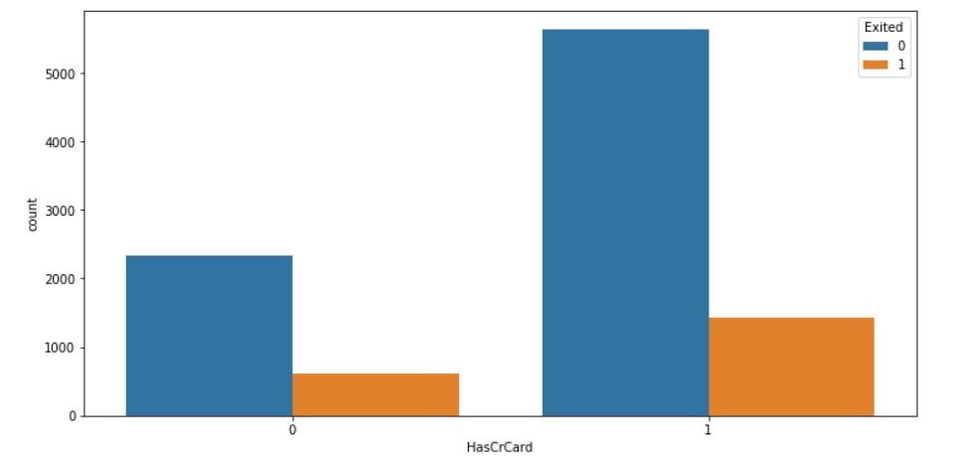
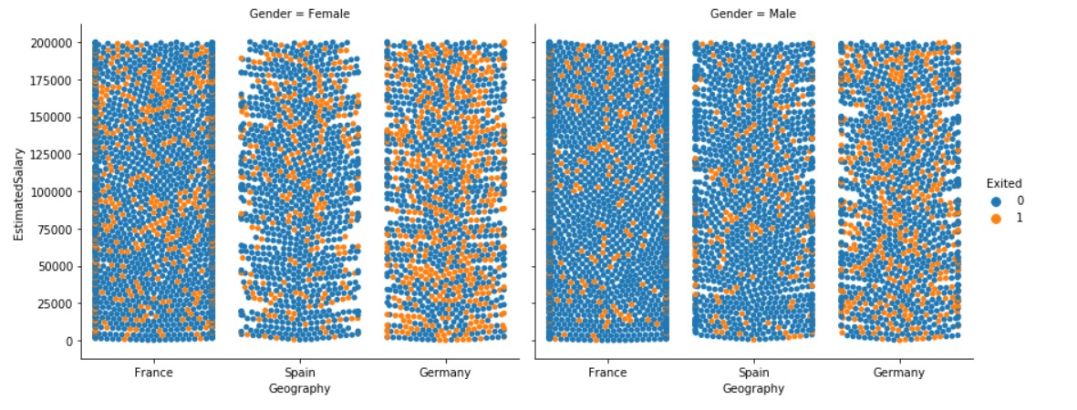
Figure. 1. Person with Credit card who has exited
Figure. 2. A Relationship of Exited according to their salary and geography

Slide 5
Problem Statement
For large companies, customer churn is one of the most critical issues. The telecommunications industry always suffers from extremely high churn rates when one industry provides a better plan than the previous one it is very difficult to prevent losses, but we can hold it to a minimal level by prediction. Because of the direct impact on the company's sales, companies aim to predict the churn of potential customers.
Therefore, it is crucial to find ways that increase customer churn to take the appropriate measures to minimize it.

Slide 6
Social Importance/ Relevance of the Problem
This project predicts customers who are likely to leave the company.
As companies offer different plans of their products customers choose the best plan according to their convenience, they can change the product anytime predicting that and providing special offers to those customers helps companies to not lose their customers.
Our project dataset is related to banks and telecom these are our project’s target groups.
Now a day's companies are migrating to the cloud so built this solution as a cloud native application with security and high availability of the application

Slide 7
Proposed Solution
In this project, we have predicted the churn of the company’s customers by using machine learning techniques. With the help of the API and Lambda, we created a user interface and provided security for the website with AWS multi-tier Architecture where our project is more focused on the architecture to provide better security and high availability for the website and our main backend part was a Machine learning model which predicts the churn of customers.
We created multiple tiers. For load balancing, setting up EC2 instances as snapshots with the help of AWS lambda we monitor a website with AWS cloud watch to ensure firm security and use SNS for to receive notification and finally securing the admin access using VPN for admin.
Since our task is quite complex and the implementation part more severe, we have split the task based on weeks on who was working on it during that span of time, its mentioned detailly in the upcoming slides.

Slide 8
Experiment and Implementation
Windows 10, Python, AWS, Git, Flask, Postman.
Register for Domain Name System.
A virtual server image will be set up in AWS that will host the website.
Churn Modelling, Classification Data set : This data set contains details of a bank's customers and the target variable is a binary variable reflecting the fact whether the customer left the bank (closed his account) or he continues to be a customer.

Slide 9
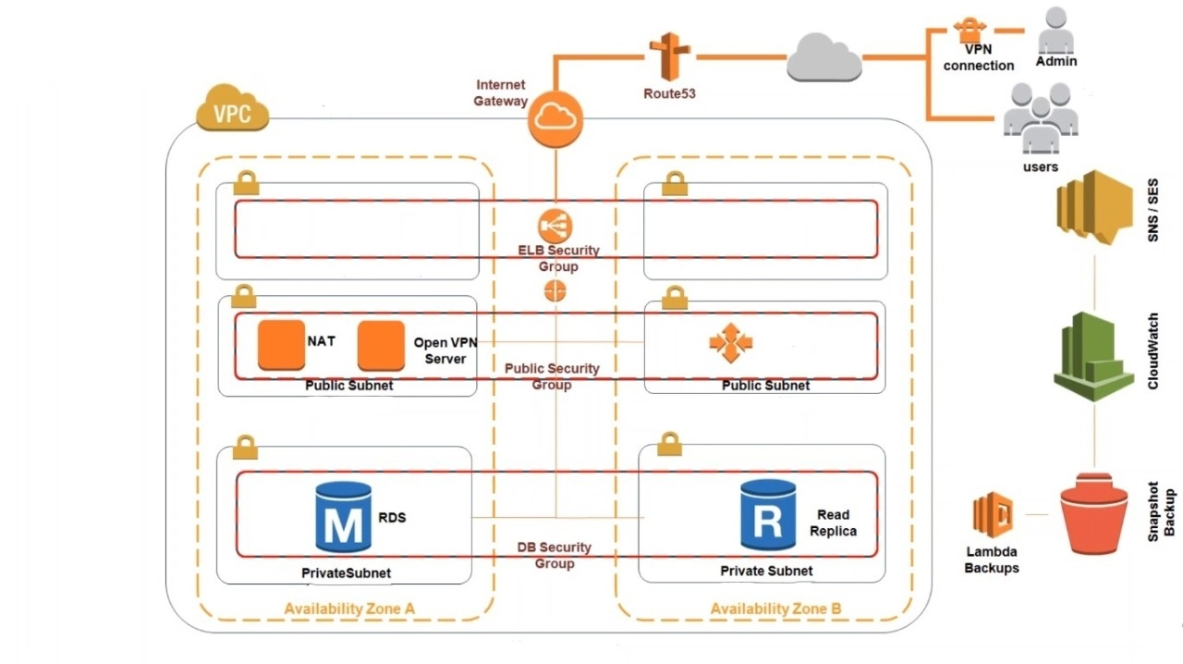
Overview of the architecture

Slide 10
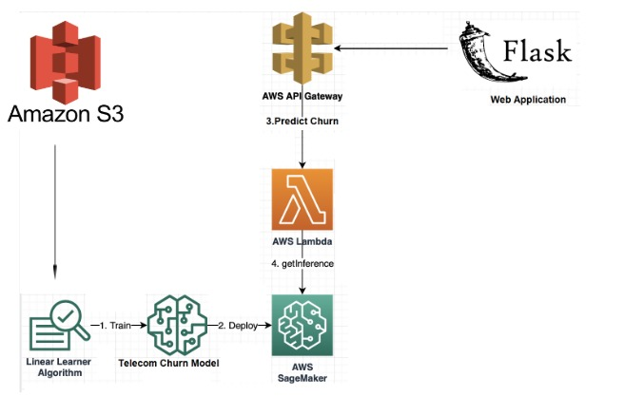
UI Interface

Slide 11
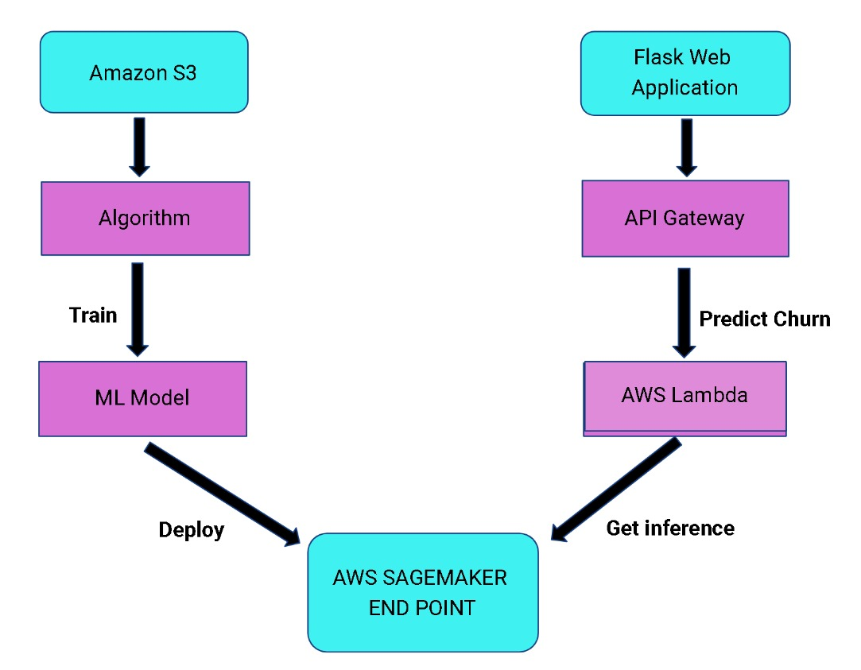
Block Diagram for Churn Prediction

Slide 12
Results Analysis and Validation
Our solution delivered an architecture with most priority to security and high availability then we developed a website with a Machine learning model using AWS Sagemaker.
We first preprocessed the data by cleaning the data and checked any duplicate or null values are present or not then visualized the data then we used label encoder to convert the strings to numerical values then we used feature scaling and created an endpoint to interact with other services and we created lambda function to trigger the ML model and we created rest API to create the website. This whole thing was secured with the architecture.
We built a prediction model using an XGboost algorithm and an achieved 73% accuracy.
By creating this architecture, we made it ensures that an unauthorized person won’t be able to access and during that process we will get a SNS regarding the attack.

Slide 13
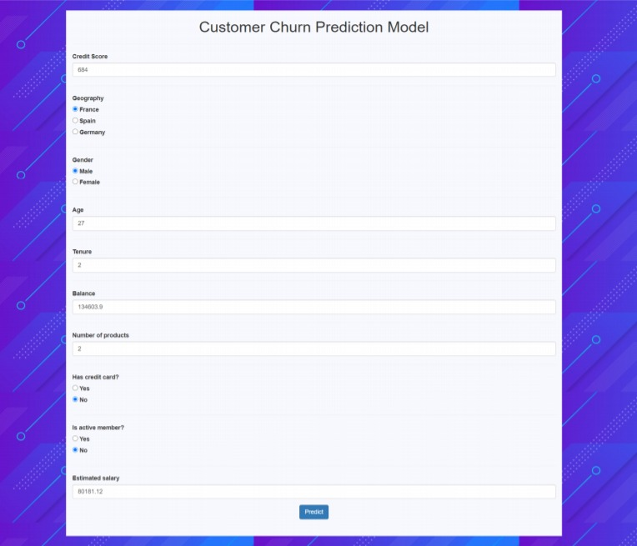
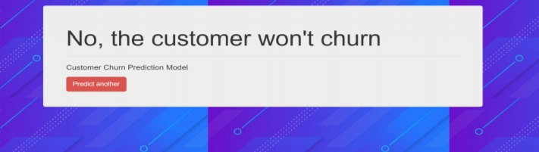
Figure. 4. Predicted result by model
Figure. 3. Form to fill the values to predict by model

Slide 14
Conclusion and Future Work
It has been a long journey(nearly 4 months) with Dr Indrajeet’s guidance and support we were able to progress smoothly because using AWS services individually is easy but integrating and compiling multiple services together is where the issue rises but after lot of trial and errors we were able to succeed It was truly a valuable experience for us.
Our future work is to enhance i.e., Since we created a website with a simple UI using HTML and CSS we want to make the website design more attractive and user friendly and we got a low accuracy while training the model so we want to increase the accuracy of the model.
Our main goal was to use as many as services of AWS to build the better application so we want to add other services like AI-powered attendance system in our website it uses the AWS recognition service we have to train the images of people which we want to detect to automatically mark attendance we have to use lambda function it triggers whenever it scans and uploads in dynamo DB to record and count the person's attendance.

Slide 15
References
1.GERPOTTTTJ,TRAMSTW,TSCHINDLERTA.TCUSTOMERTRETENTION,TLOYALTY,TANDTSATISFACTIONTINTTHETGERMANTMOBILETCELLULARTTELECOMMUNICATIONSTMARKET.TTELECOMMUNTPOLICY.T2001;T25:249–69.
2.NGURAHTPUTUTOKATH,TAJIBTSETYOTARIFIN,T"TELECOMMUNICATIONTSERVICETSUBSCRIBERTCHURNTLIKELIHOODTPREDICTIONTANALYSISTUSINGTDIVERSETMACHINETLEARNINGTMODEL",TMECHANICALTELECTRONICSTCOMPUTERTANDTINDUSTRIALTTECHNOLOGYT(MECNIT)T2020T3RDTINTERNATIONALTCONFERENCETON,TPP.T24-29,T2020.
3.WOUTERTVERBEKE,TDAVIDTMARTENS,TCHRISTOPHETMUES,TBARTTPREDICTIONTMODELSTWITHTADVANCEDTRULETINDUCTIONT(2011)T2354–2364.BAESENST“BUILDINGTCOMPREHENSIBLETCUSTOMERTCHURN TECHNIQUES”,TEXPERTTSYSTEMSTWITHTAPPLICATIONST38T
4.YUTW,TJUTLATDN,TSIVAKUMARTSC.TATCHURNSTRATEGYTALIGNMENTTMODELTFORTMANAGERSTINTMOBILETTELECOM.TIN:TCOMMUNICATIONTNETWORKSTANDTSERVICESTRESEARCHTCONFERENCE,TVOL.T3.T2005.TP.T48–53.
5.MAKHTARTM,TNAFISTS,TMOHAMEDTM,TAWANGTM,TRAHMANTM,TDERISTM.TCHURNTCLASSIFICATIONTMODELTFORTLOCALTTELECOMMUNICATIONTCOMPANYTBASEDTONTROUGHTSETTTHEORY.TJTFUNDAMTAPPLTSCI.T2017;9(6):854–68.
6.ZHAOTY,TWANGTG,TYUTPS,TLIUTS,TZHANGTS.TINFERRINGTSOCIALTROLESTANDTSTATUSESTINTSOCIALTNETWORKS.TIN:TKDDT201319THTACMTSIGKDDTINTERNATIONALTCONFERENCETONTKNOWLEDGETDISCOVERYTANDTDATATMINING.TASSOCIATIONTFORTCOMPUTINGTMACHINERY;T2013.TP.T695–703
7.XIETJ,TROJKOVATV,TPALTS,TCOGGESHALLTS.TATCOMBINATIONTOFTBOOSTINGTANDTBAGGINGTFORTKDDTCUPT2009FASTTSCORINGTONTATLARGETDATABASE.TJTMACHTLEARNTRESTPROCTTRACK.T2009;T7:35–43.

Slide 16
YouTube Video Link and Blog link
YouTube video Web Link – https://www.youtube.com/watch?v=Y4mqcFsHgTQ&ab_channel=BODDEDAAVINASH
Blog Web Link - https://medium.com/@nr3702/aws-multi-tier-architecture-863bc6bc26b4
GitHub Code Web Link - https://github.com/Ba5314/AWS-Multi-Tier-Architecture.git

Slide 17
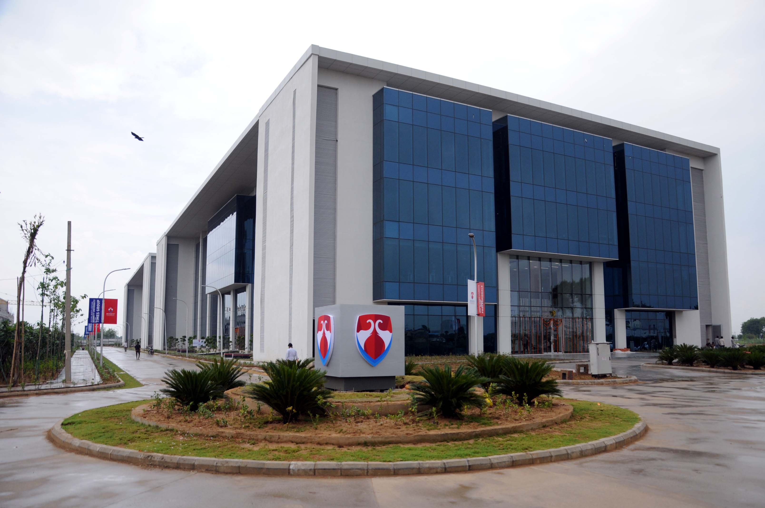
Question Please Thank You

